Slide 1
Project Presentation of CO-OP Project at Industry (Module-2) (22CS421)
On
Smart AI Cataloging Application (Team-32)
Supervised By
Dr.Rajat Takkar
Department of Computer Science and Engineering,
Chitkara University, Punjab
Name | EMP CODE/ROLL
Shivansh Sood | 2210992328
Sahil Arya | 2210990757
Rishi Kumar | 2210992161
Dhruv Sood | 2210990279

Slide 2
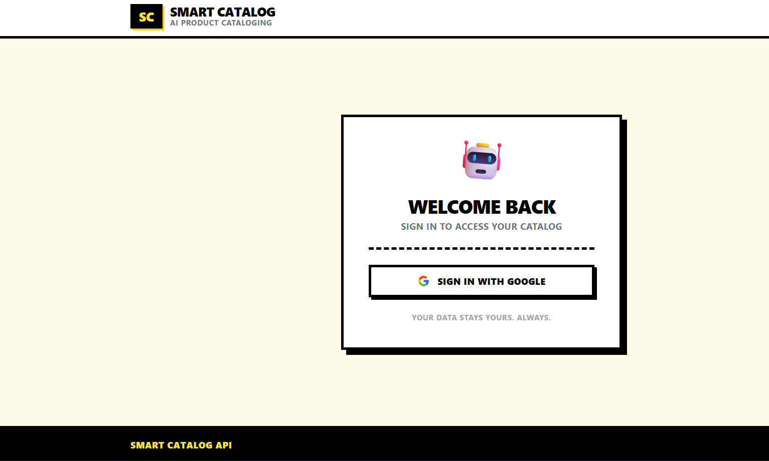
Project Objectives
Automate e-commerce product cataloging using AI
Eliminate manual data entry for product titles, descriptions, categories, tags
Generate SEO-optimized catalog entries from product images and/or text descriptions
2

Slide 3
Methodology / Approach
User uploads a product image, text description, or both
Backend sends input to Google Gemini AI with engineered prompts
Gemini returns structured JSON: title, description, category, attributes, tags, keywords
Results stored in MySQL and displayed on the React frontend
Supports single item and batch cataloging

Slide 4
Key Findings / Outcomes
Reduced cataloging time from minutes to seconds per product
Consistent category and tag assignment across products
SEO-optimized titles and descriptions generated automatically
Confidence scoring on each AI-generated entry
Price positioning (budget / mid-range / premium) inferred from product features

Slide 5
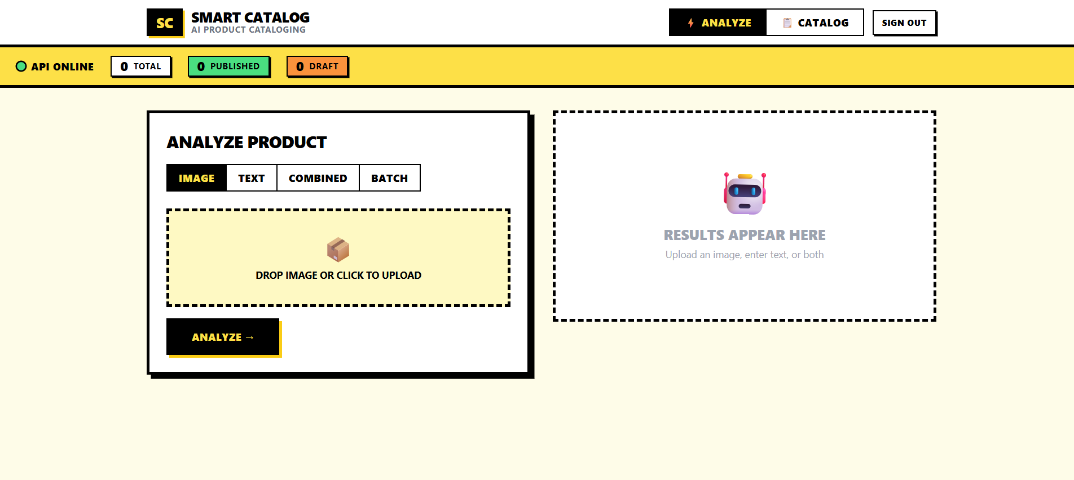
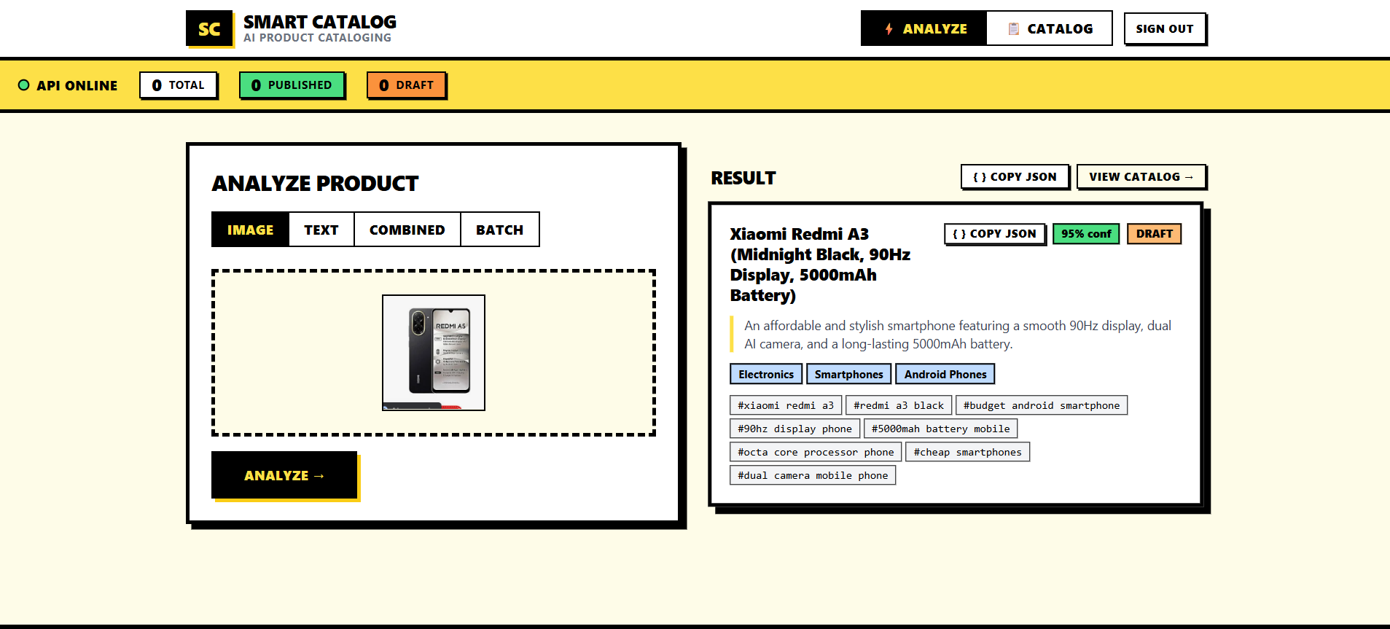

Slide 6
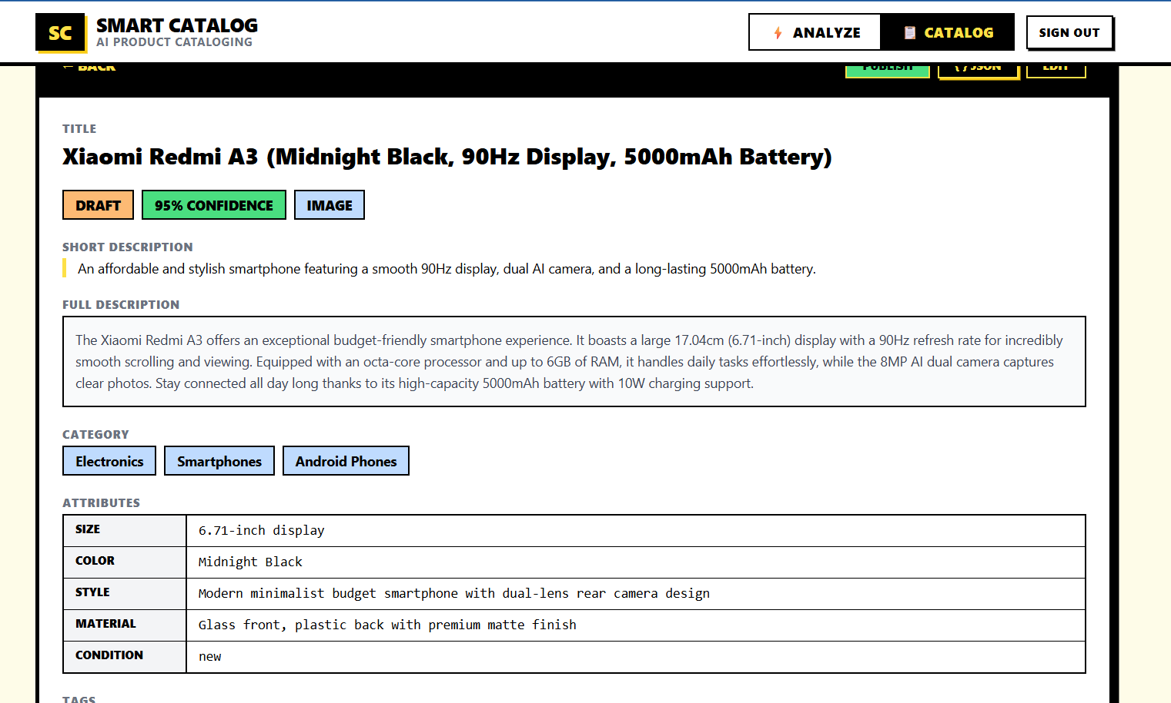
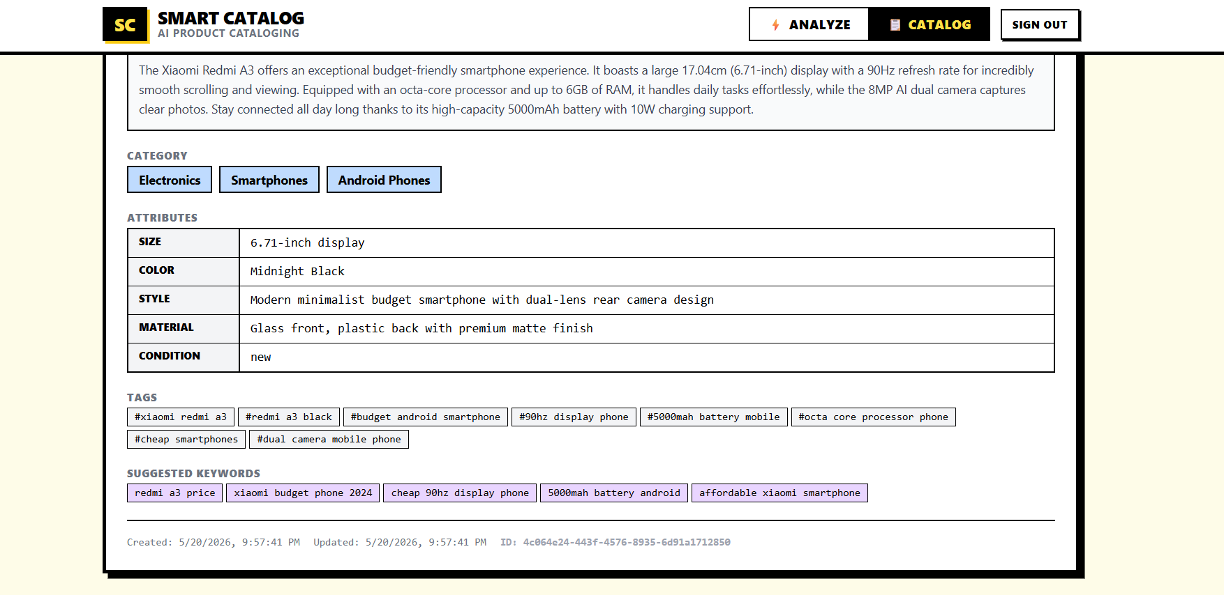

Slide 7
Conclusion & Future Scope
Conclusion: Successfully built an AI-powered cataloging tool that automates structured product data generation for e-commerce
Future Scope:
1.Support for more AI models (OpenAI, Claude)
2.Bulk CSV import/export
3.Multi-language catalog generation
4.Integration with platforms like Shopify / WooCommerce

Slide 8
Thank You
8

